Slide 1
Stupa, Relics and Qualities of Buddha

Slide 2
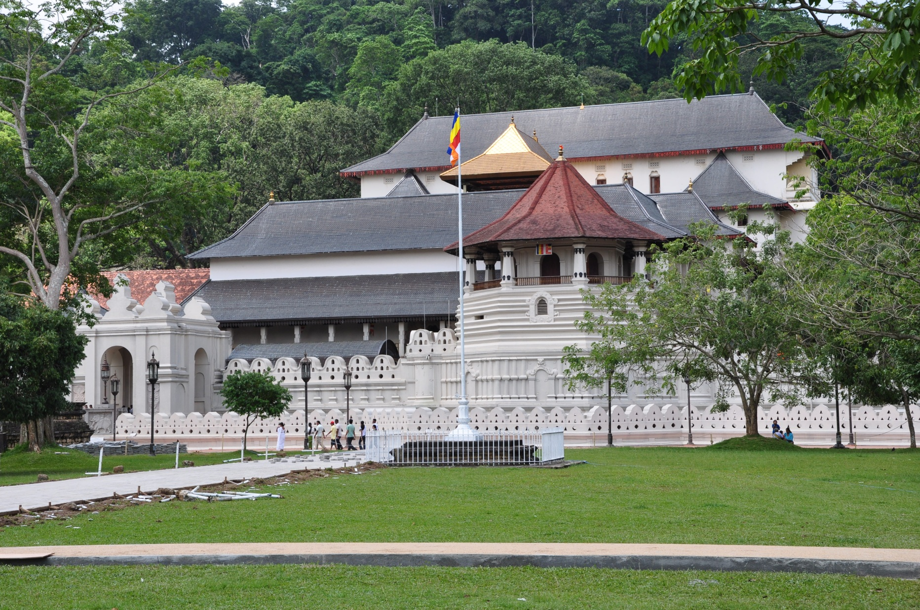
Dalada Maligaya

Slide 3
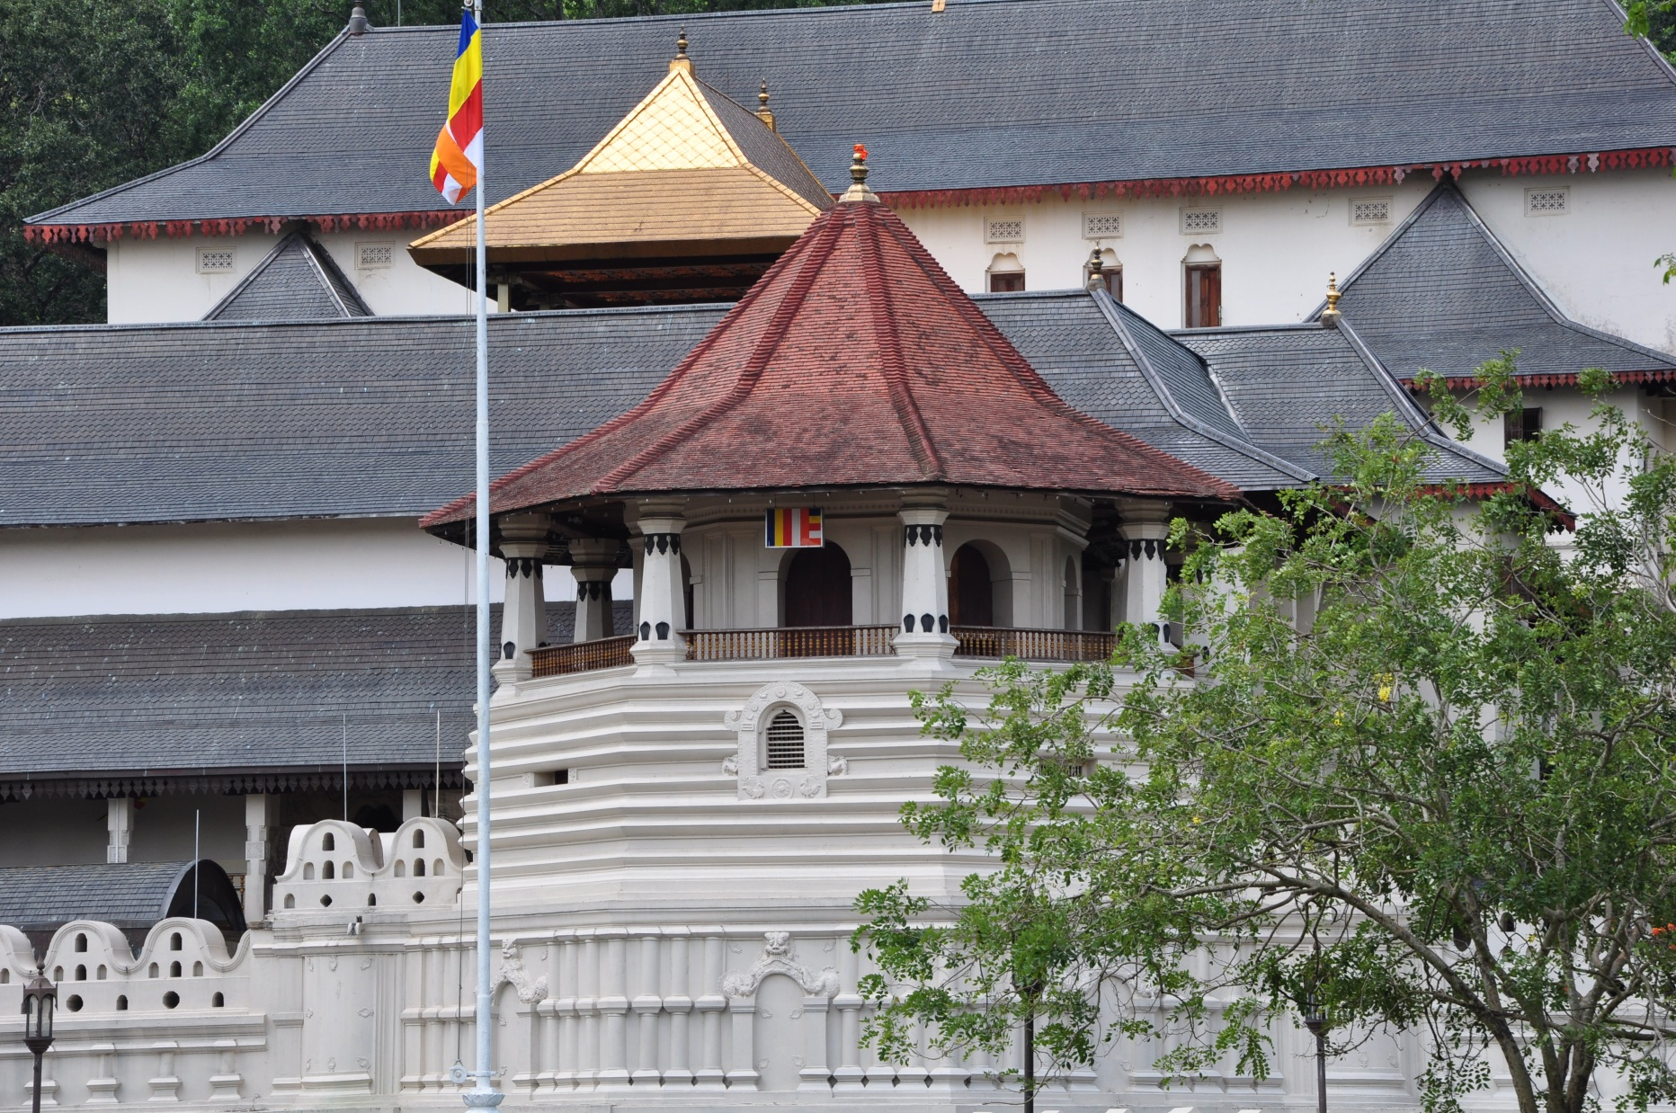
Dalada Maligaya

Slide 4
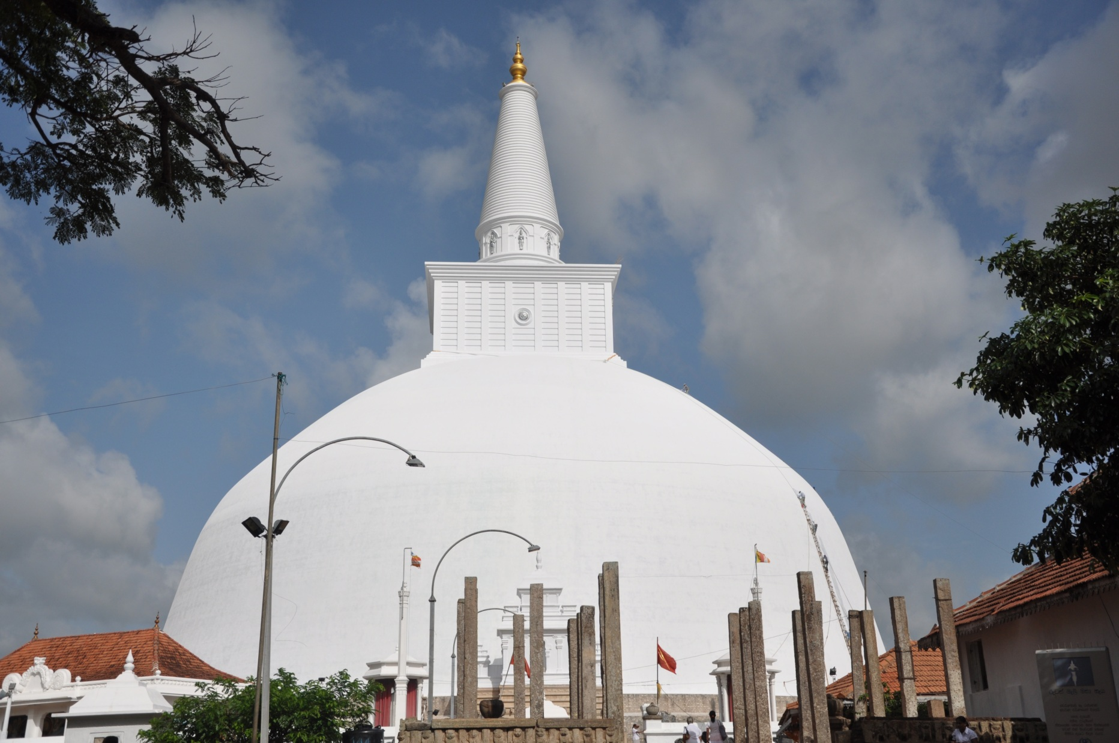
Ruwanwelisaya Stupa

Slide 5
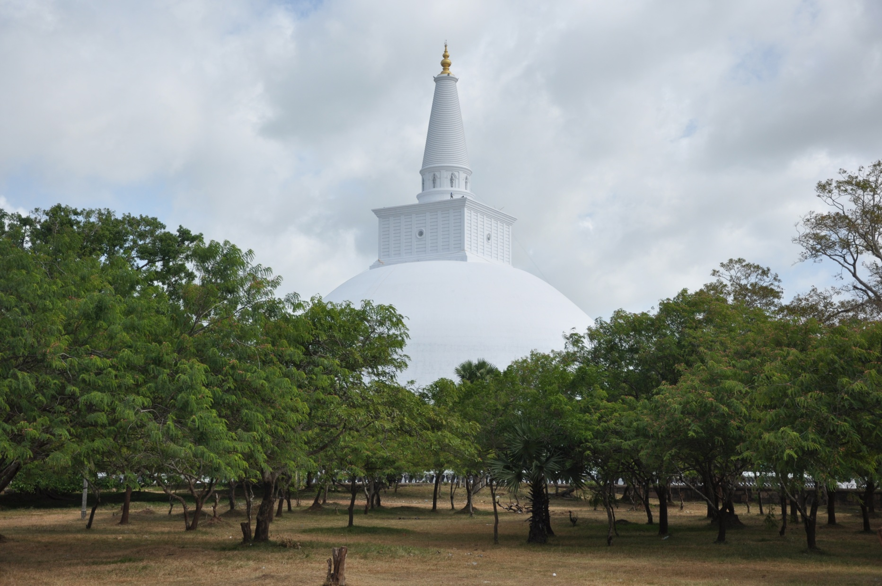
Ruwanwelisaya Stupa

Slide 6
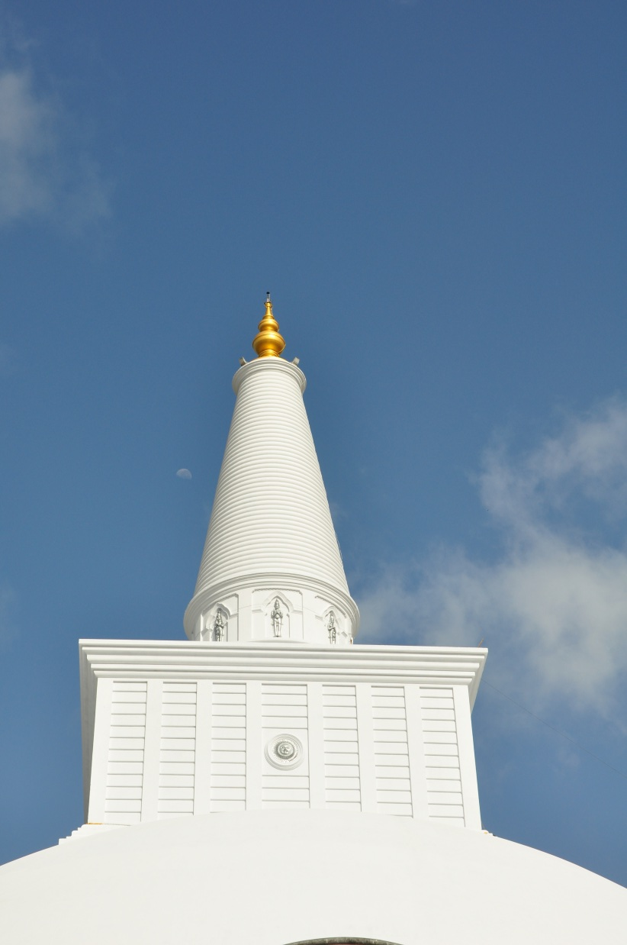
Ruwanwelisaya Stupa

Slide 7
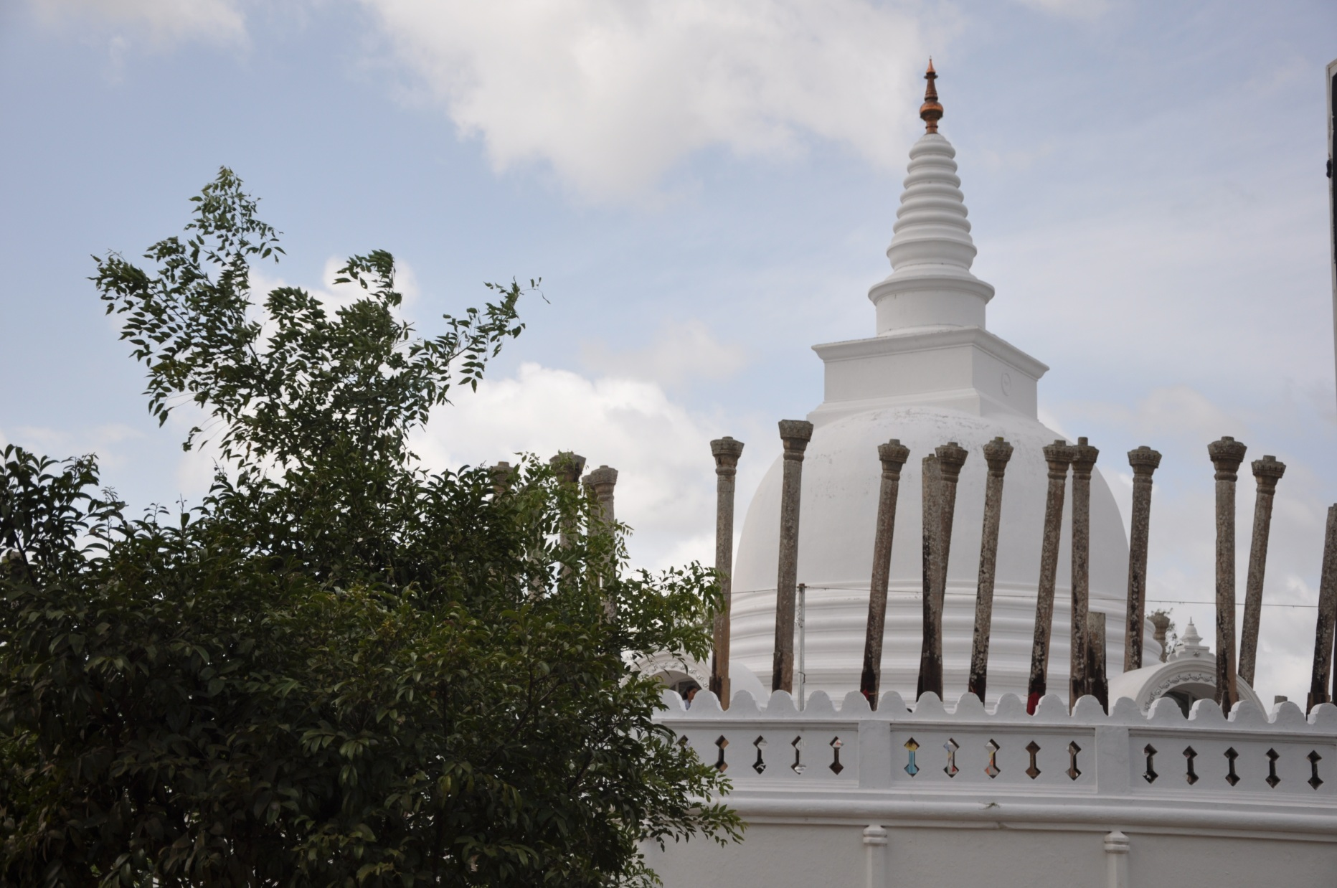
Thuparama Stupa

Slide 8
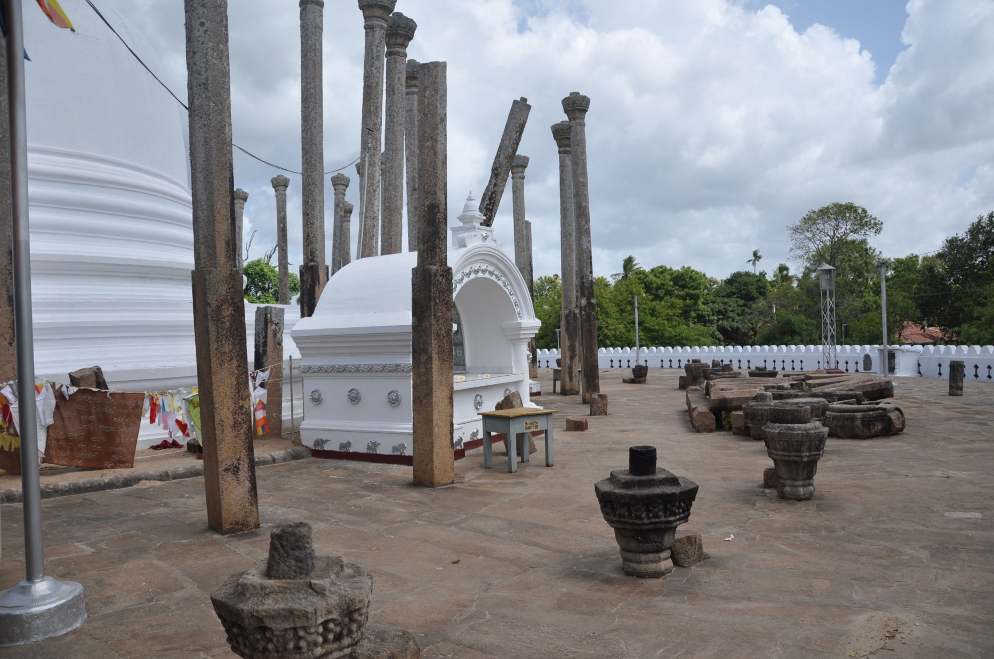
Thuparama Stupa

Slide 9
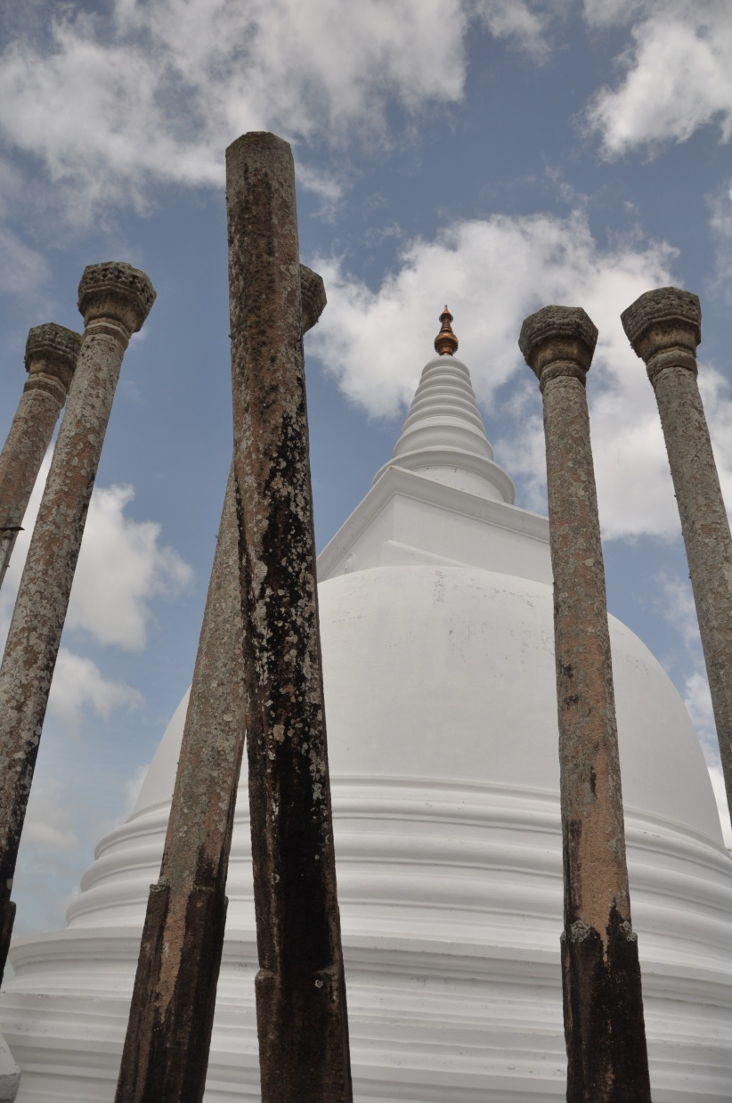
Thuparama Stupa

Slide 10
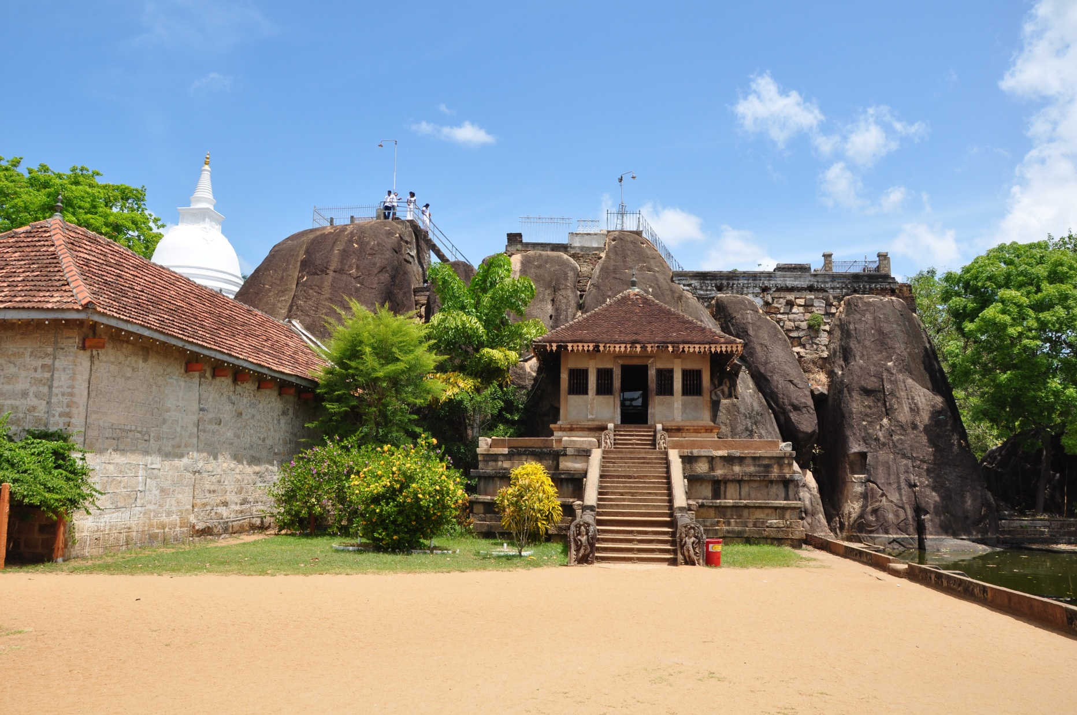
Isurumuniya

Slide 11
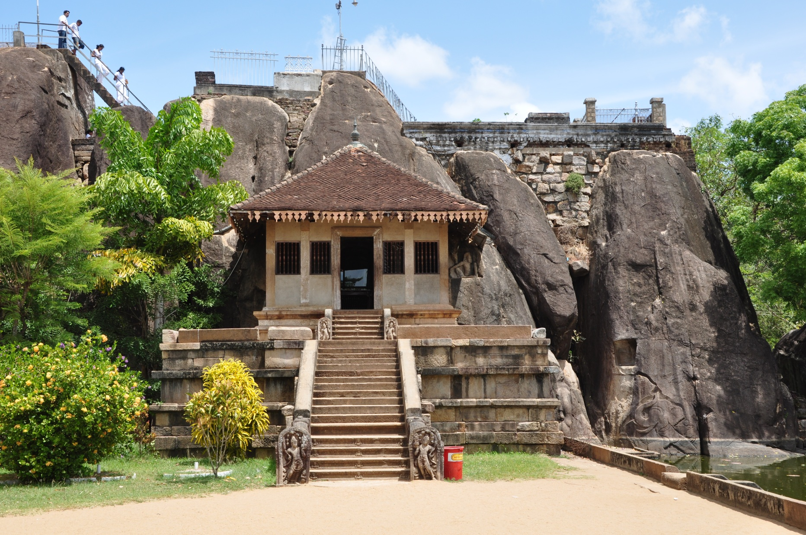
Isurumuniya

Slide 12
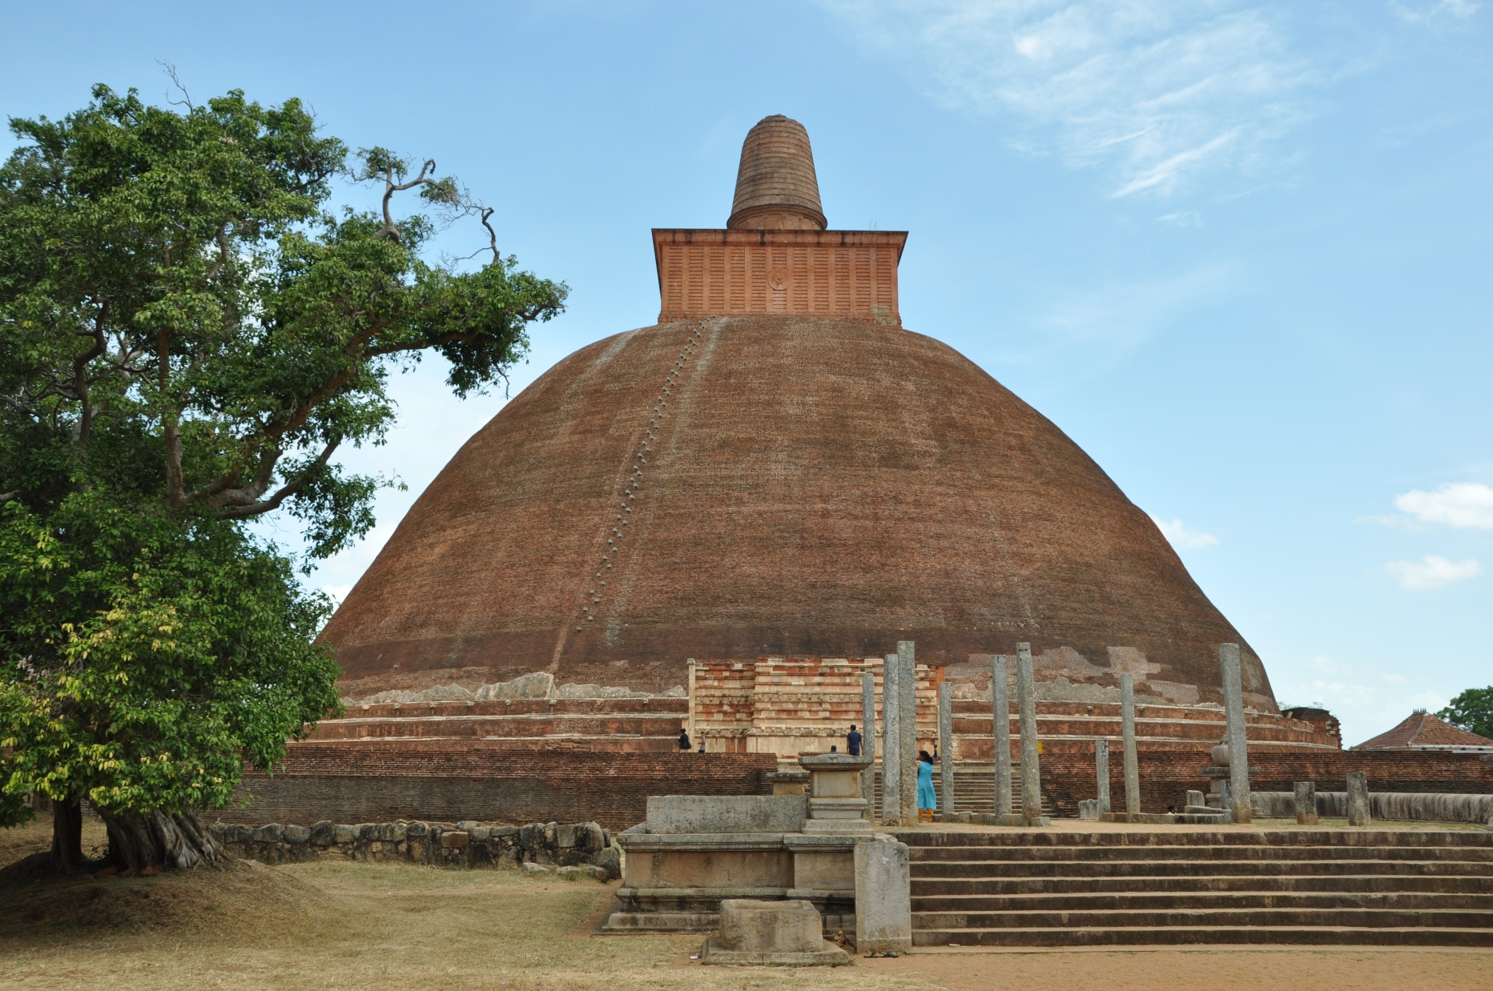
Jetavanarama Stupa

Slide 13
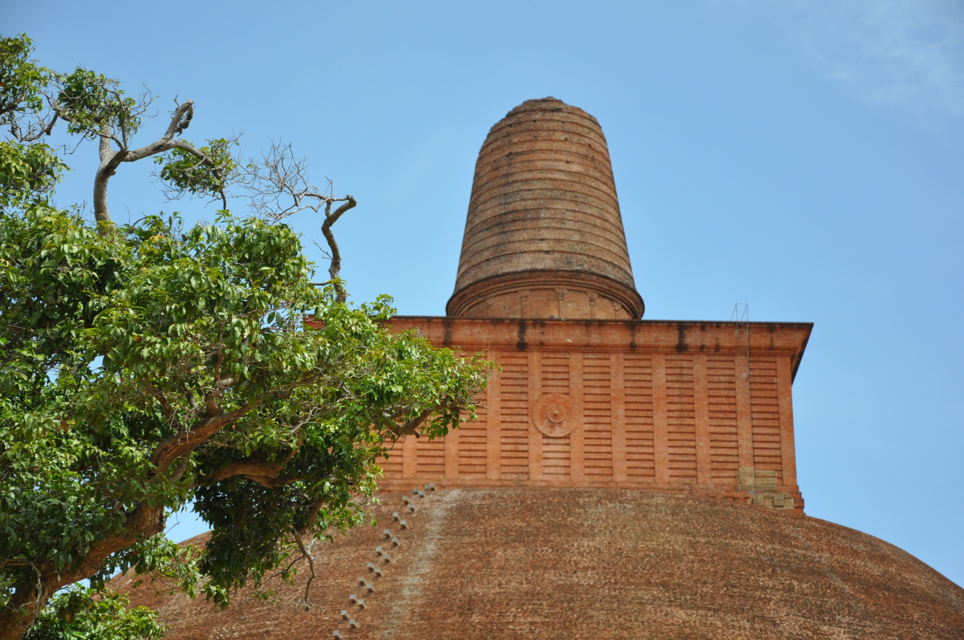
Jetavanarama Stupa

Slide 14
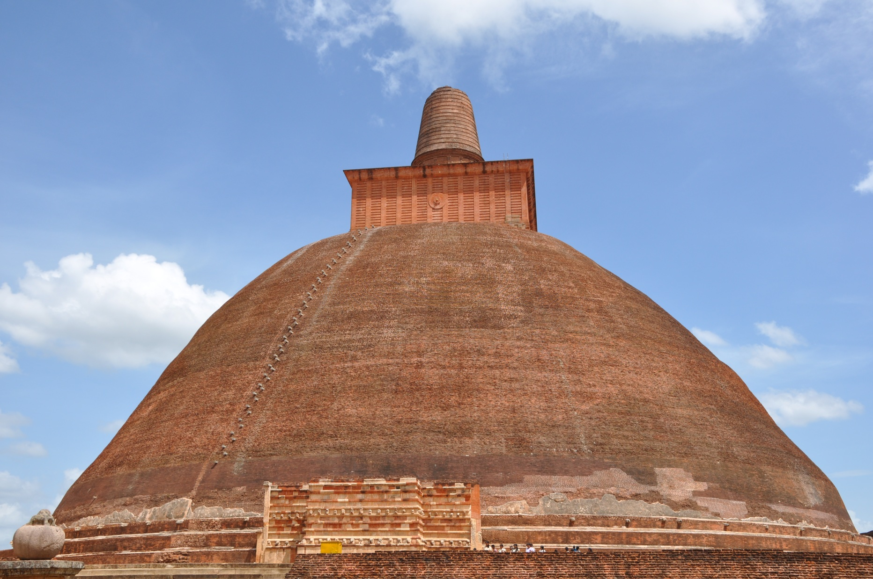
Jetavanarama Stupa

Slide 15
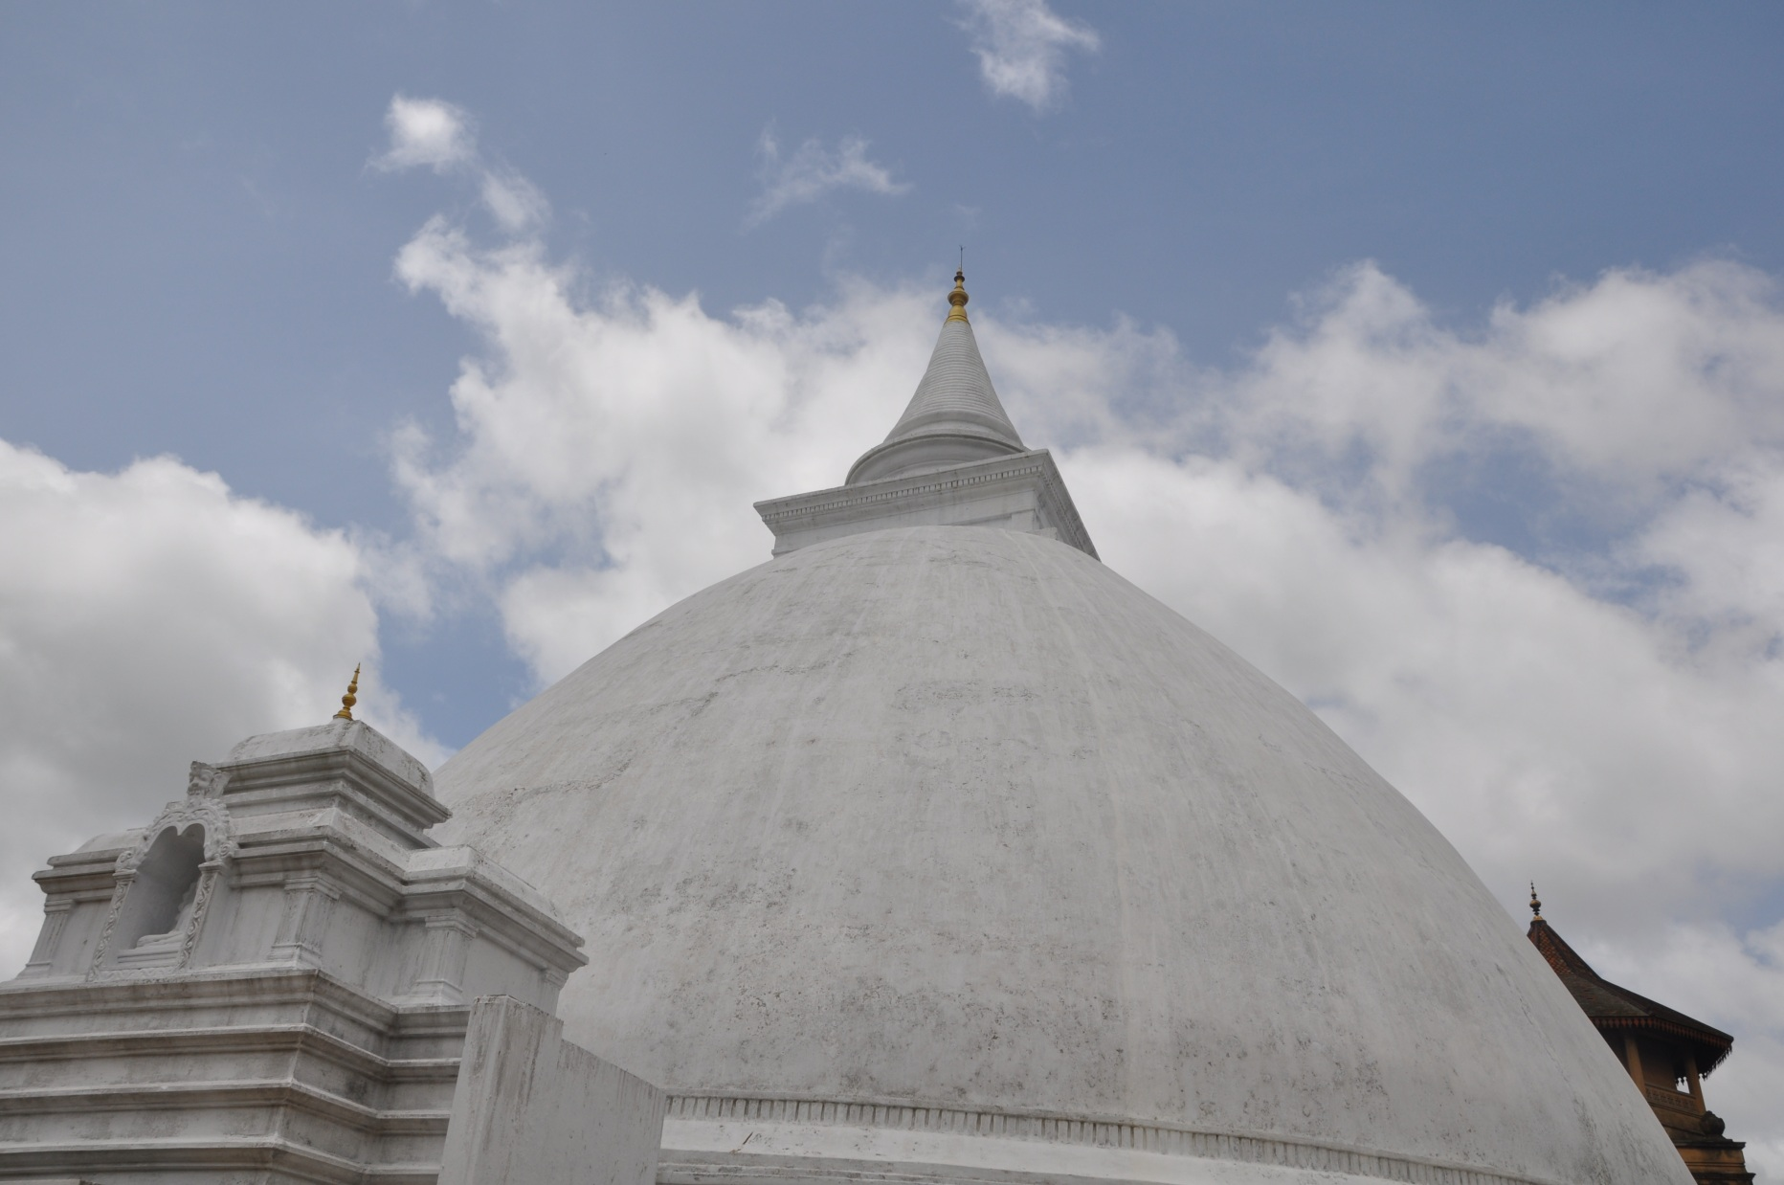
Kelaniya Stupa

Slide 16
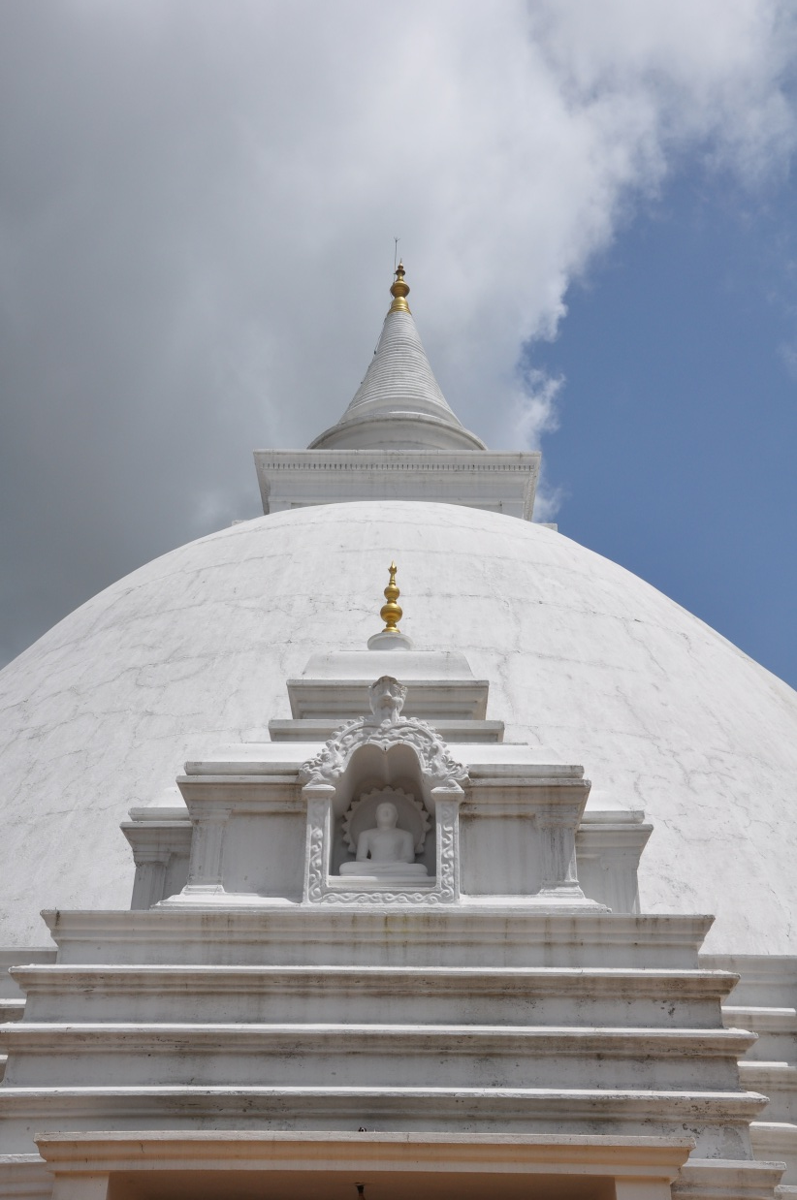
Kelaniya Stupa

Slide 17
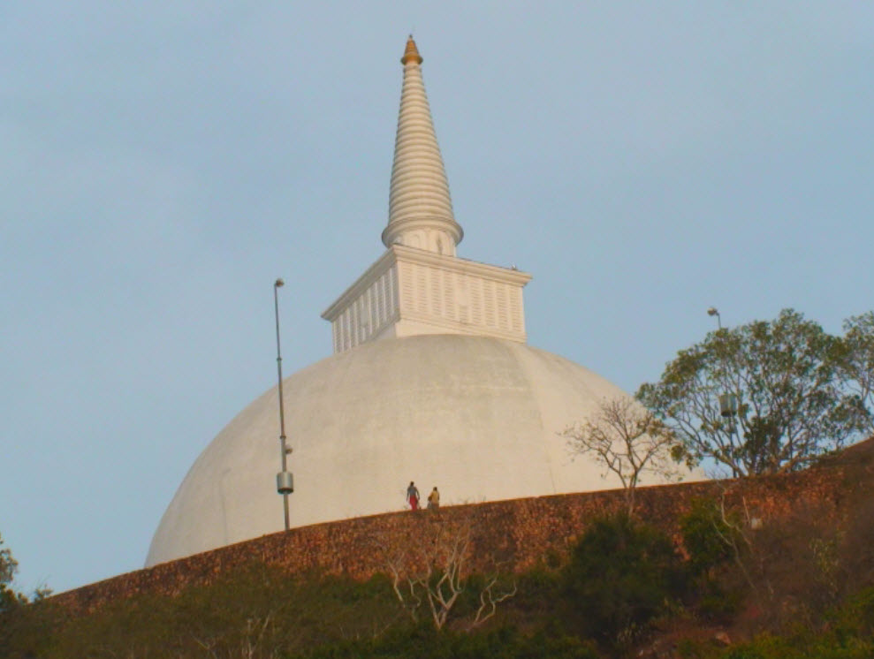
Mihinthale Stupa

Slide 18
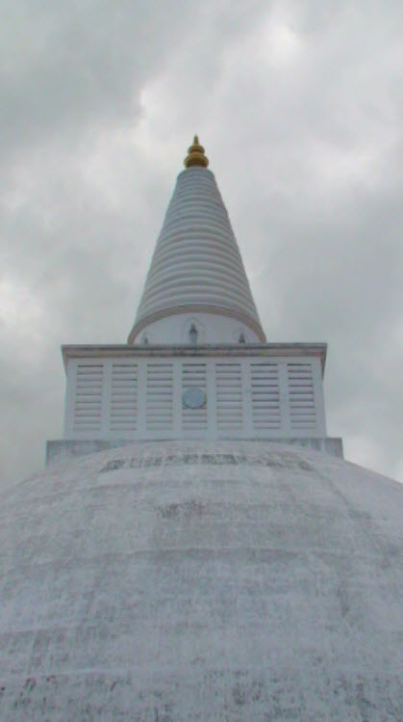
Mirisaveti Stupa

Slide 19
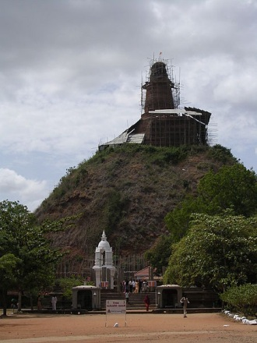
Abhayagiri Stupa

Slide 20
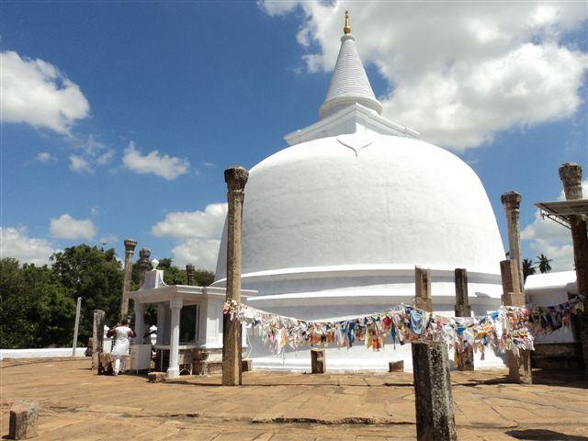
Lankarama Stupa

Slide 21
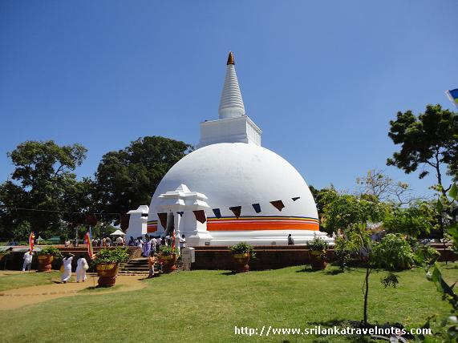
Somawathie Stupa

Slide 22
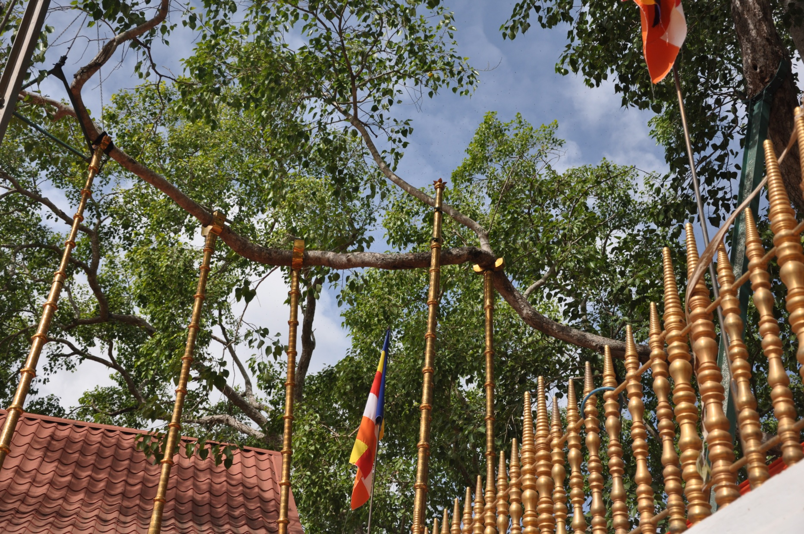
Jaya Sri Maha Bodhi Tree

Slide 23
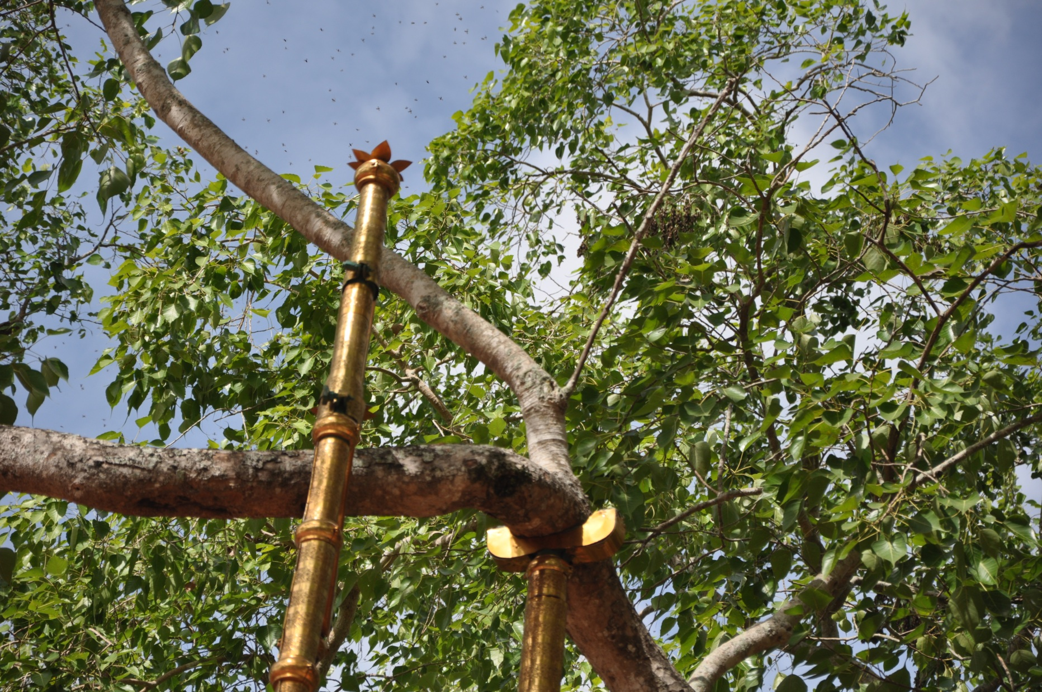
Jaya Sri Maha Bodhi Tree

Slide 24
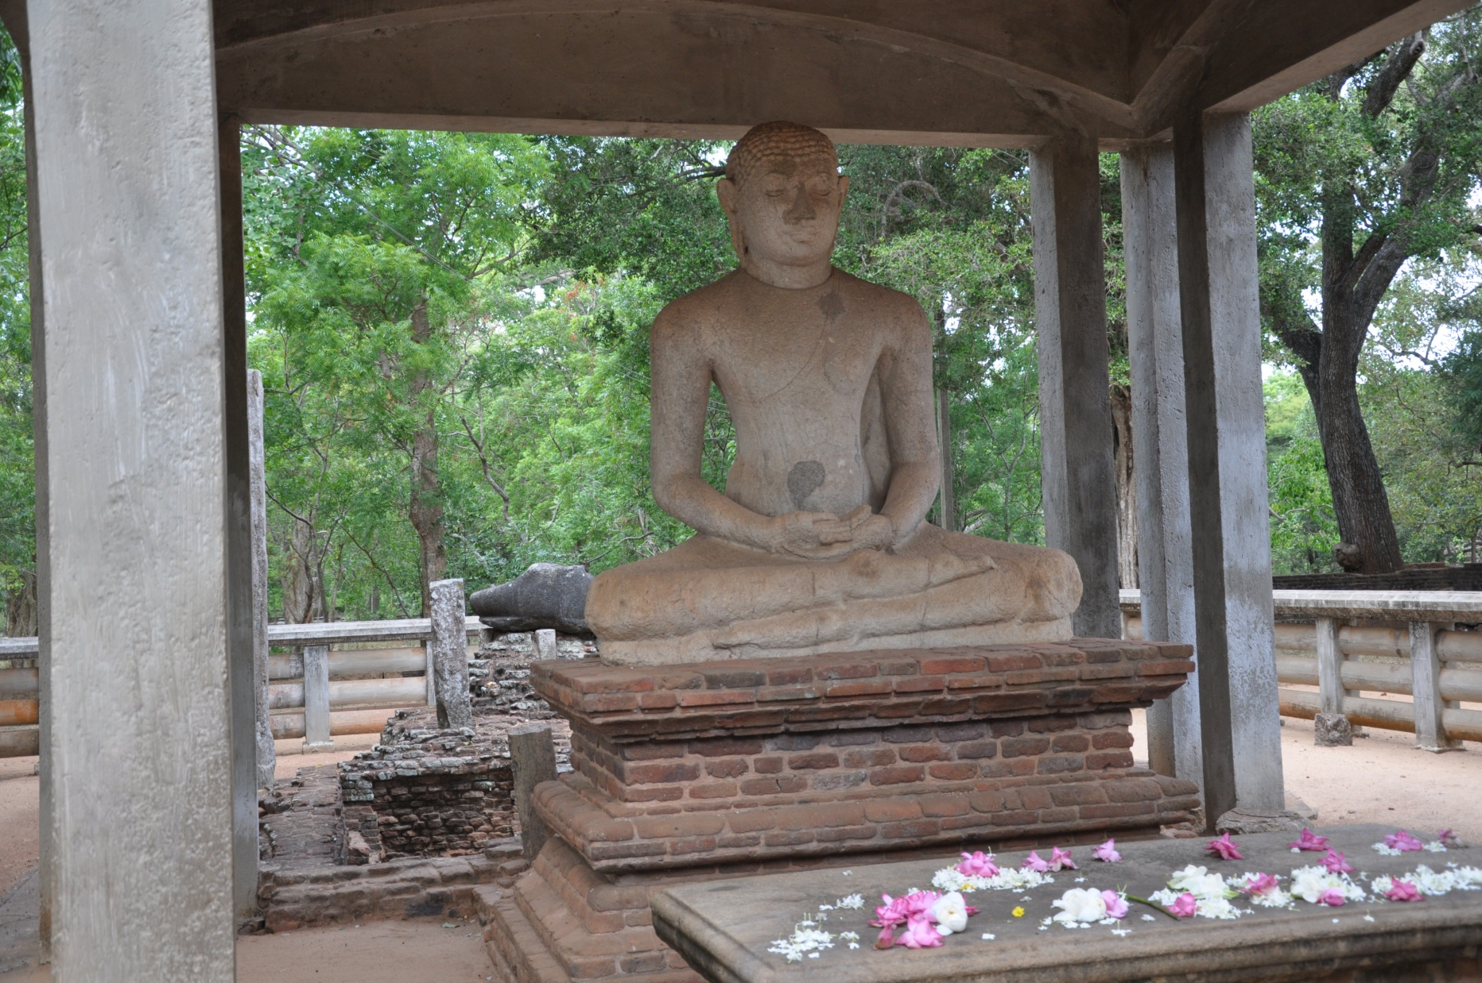
Samadhi Statue

Slide 25
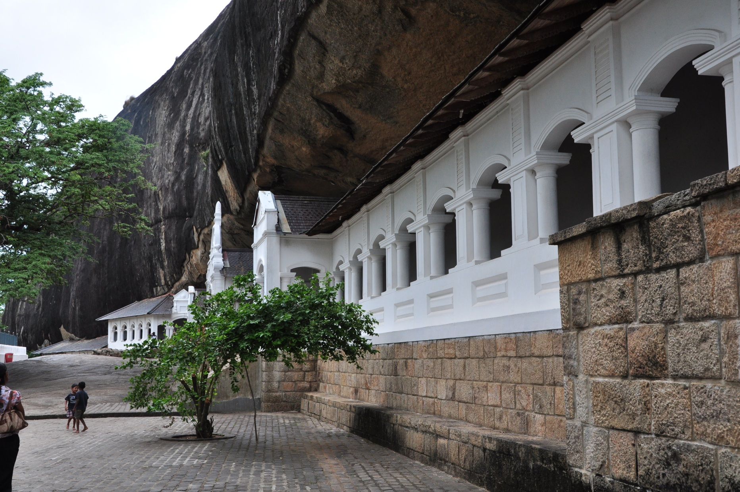
Dambulla cave temple

Slide 26
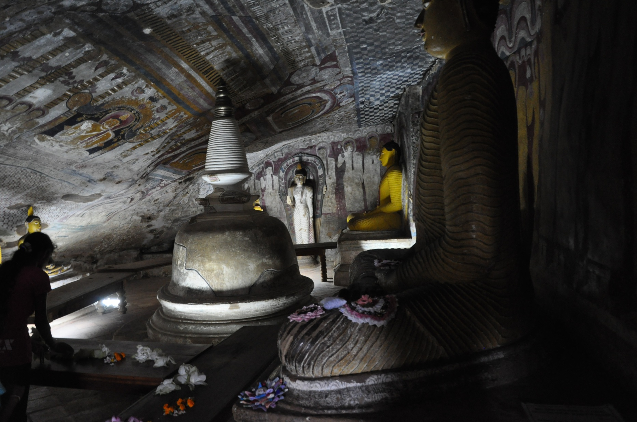
Dambulla cave temple

Slide 27
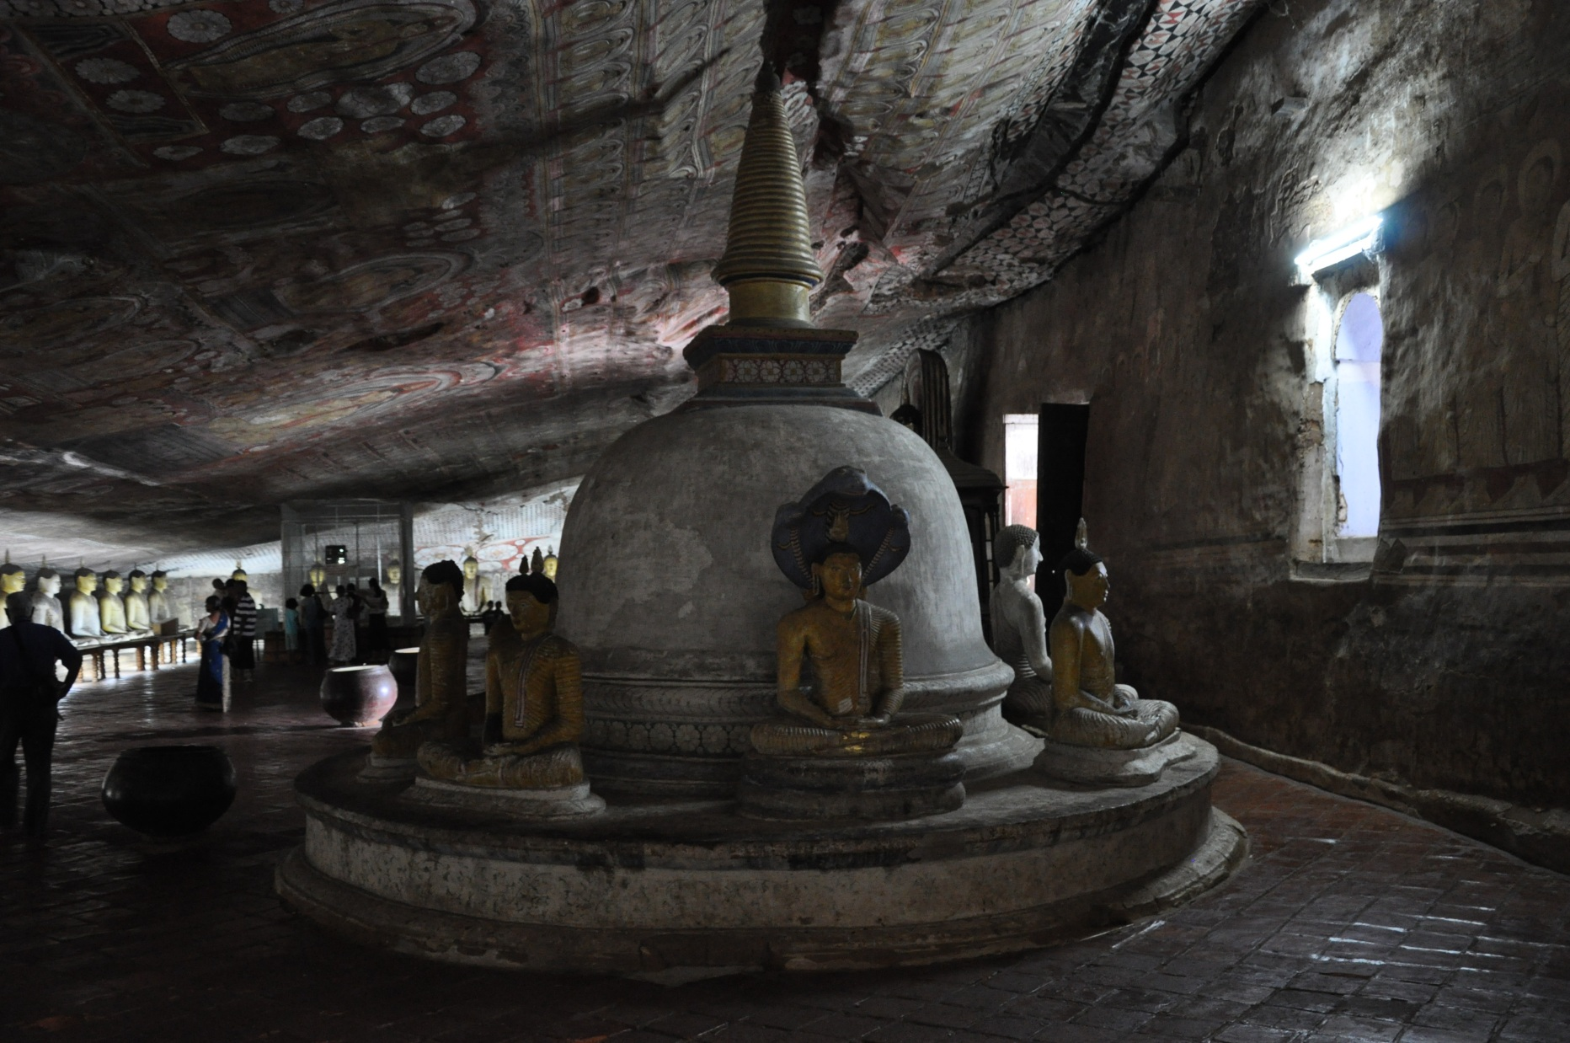
Dambulla cave temple

Slide 28
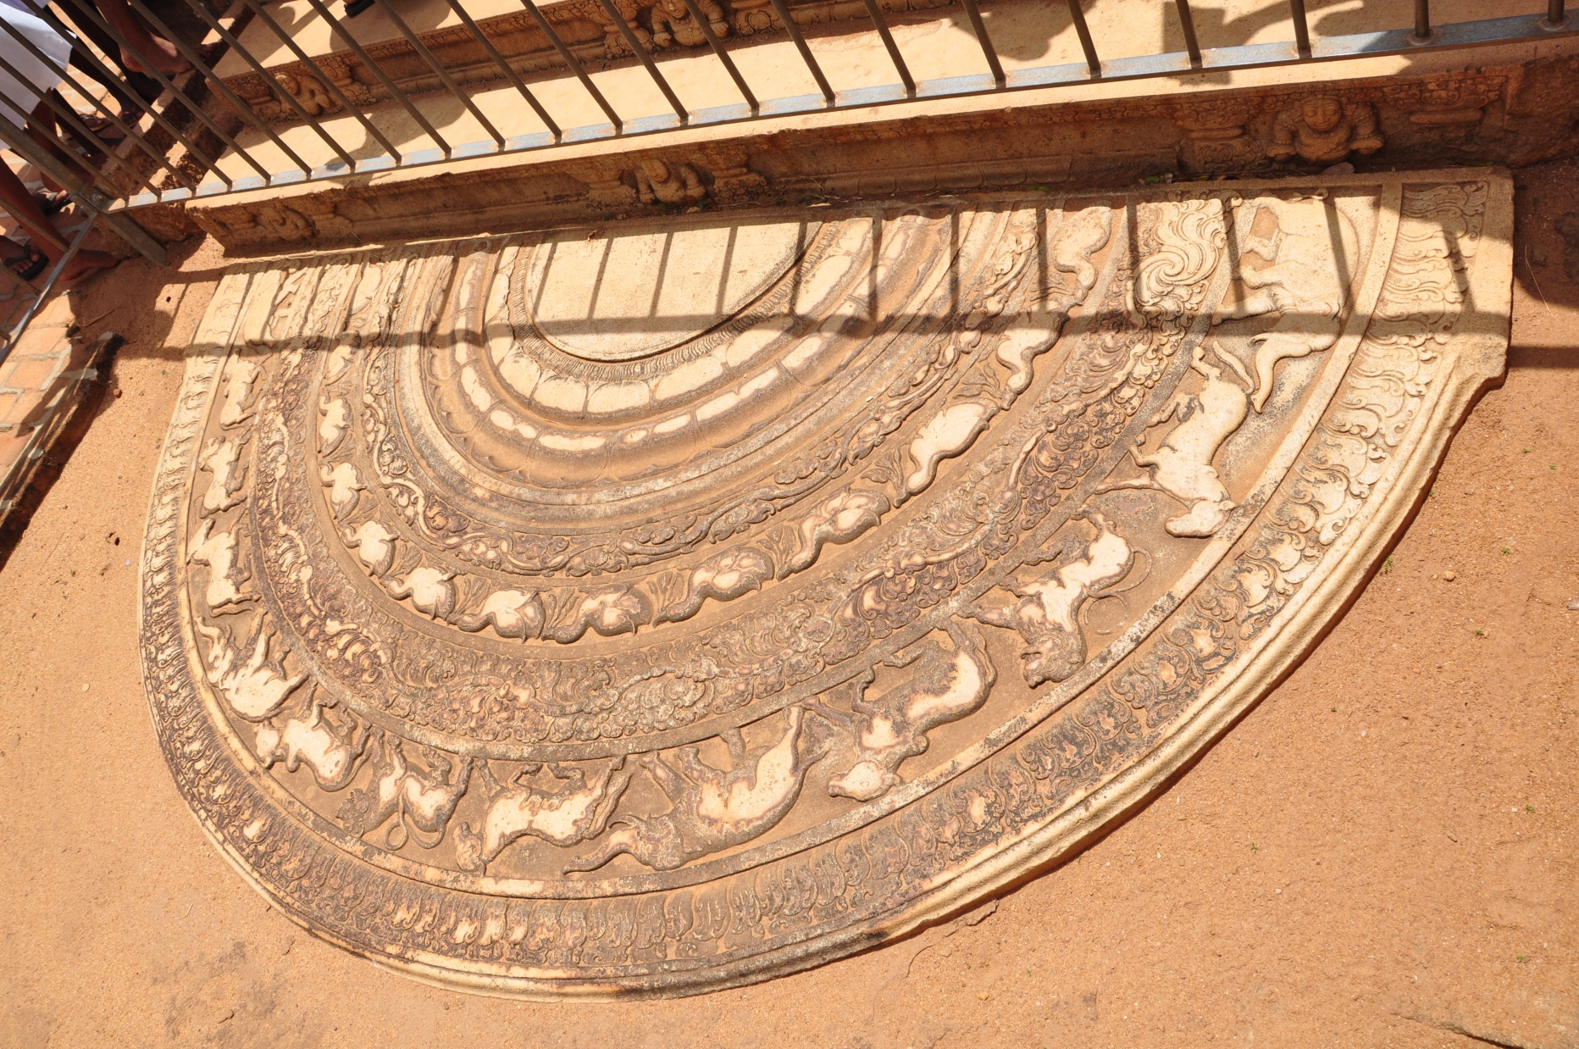
Moon Stone (Sandakada Pahana)

Slide 29
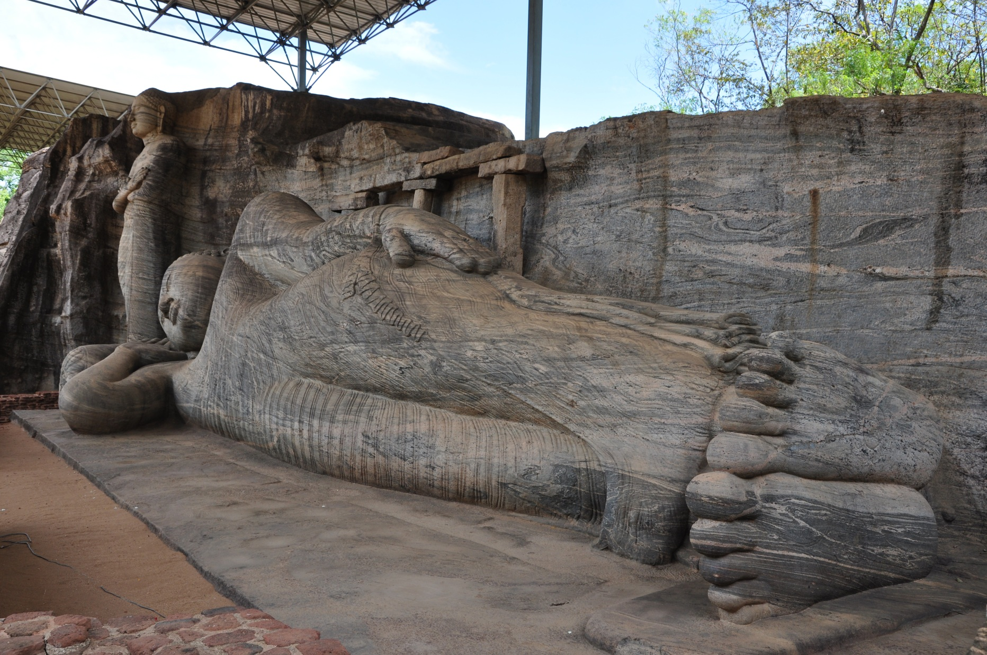
Gal Viharaya

Slide 30
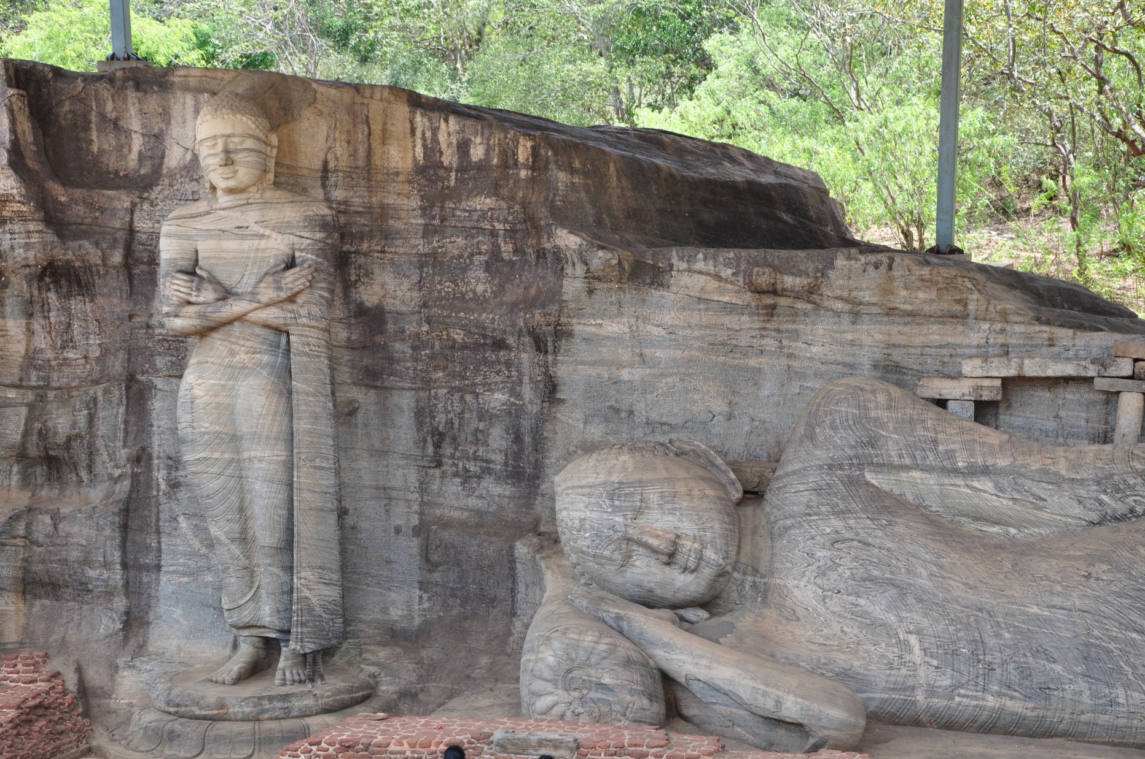
Gal Viharaya

Slide 31
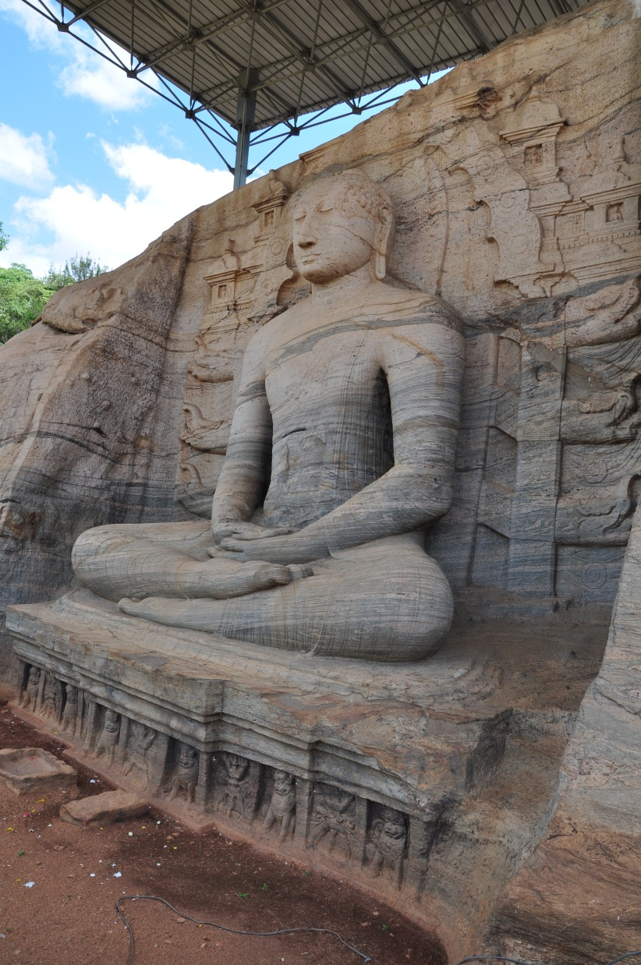
Gal Viharaya

Slide 32
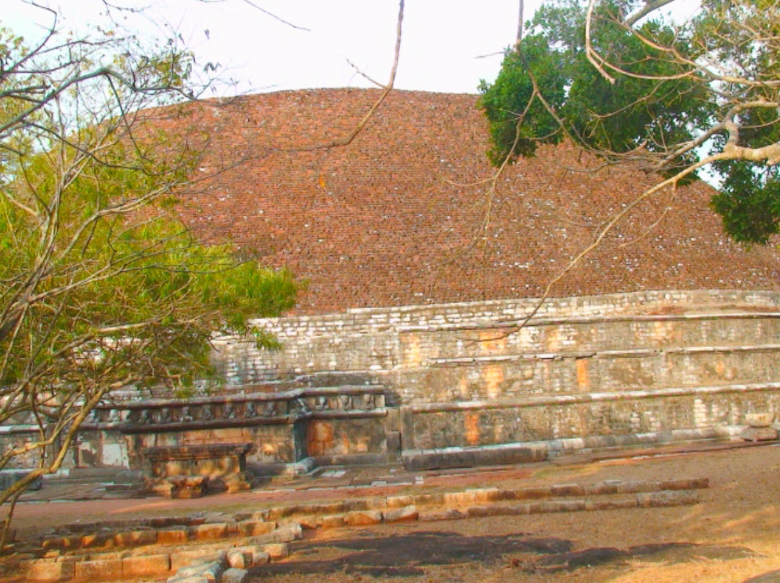
Kantaka Stupa

Slide 33
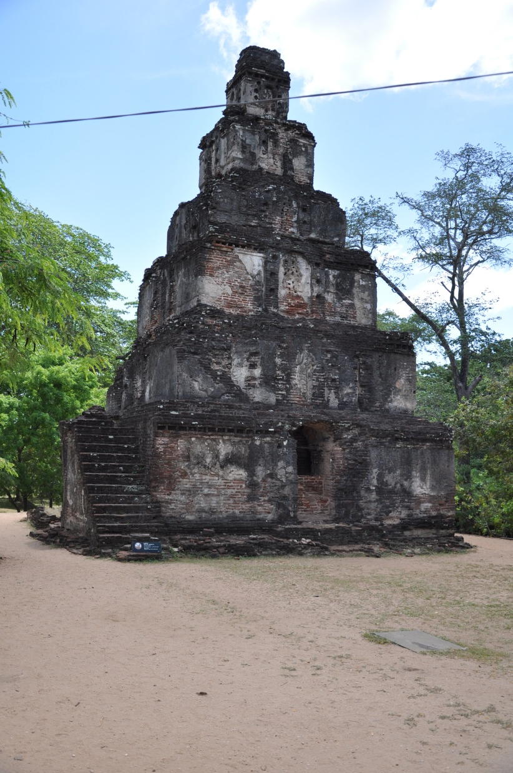
Seven Storey Building

Slide 34
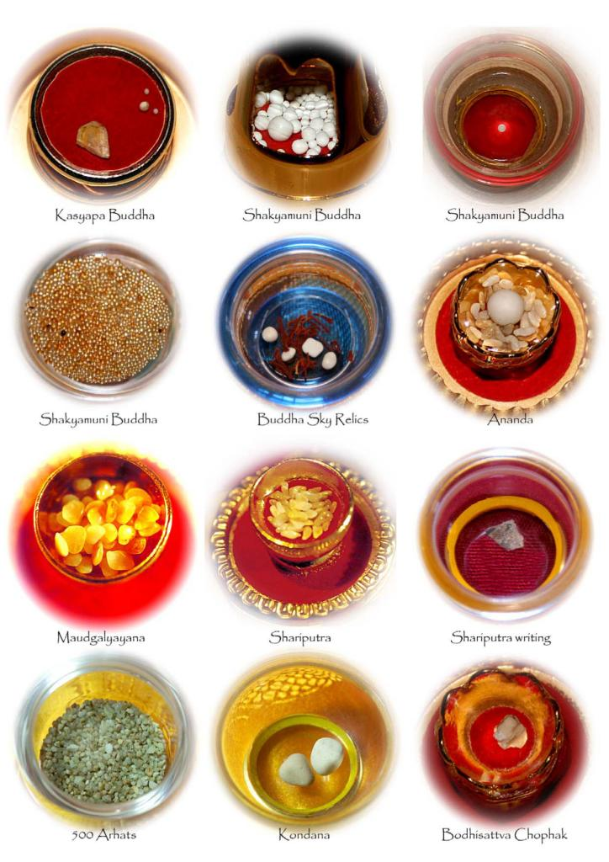

Slide 35
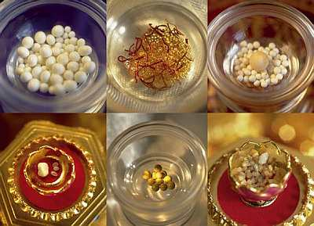

Slide 36
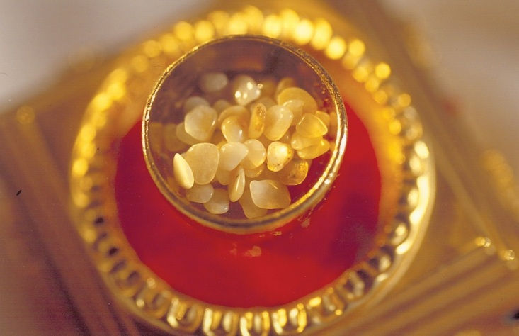

Slide 37
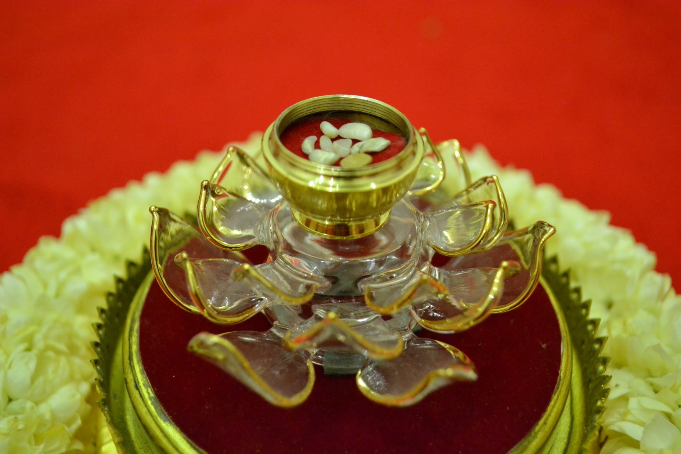

Slide 38
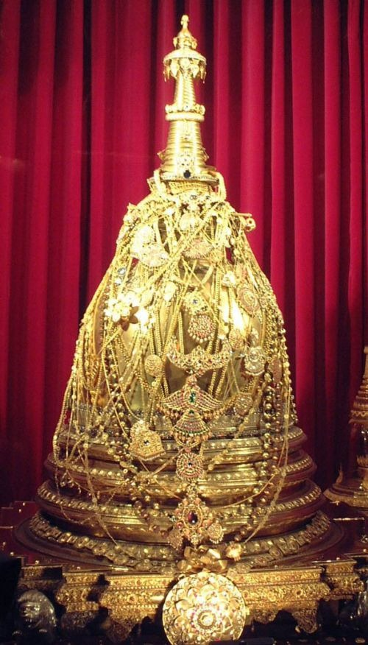

Slide 39
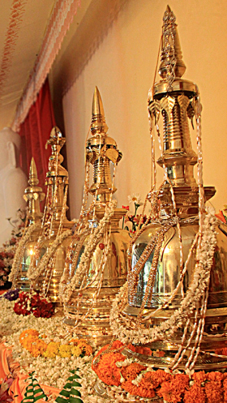

Slide 40
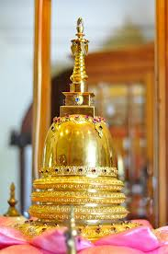

Slide 41
